Slide 1
One-Handed Controller
By: SoftWhere
Jonathan Jay - 100743575
Matthew McPherson - 100757379
Léo Buono - 100748457

Slide 2
Product Description
We intend to create a one-handed video game controller
This controller will allow people to use all the same inputs as a standard controller has (2 joysticks, 4 face buttons, d-pad, 2 bumpers, 2 triggers, and start and select), while only requiring one hand to use.
The goal is to improve the player experience and make it easier to play compared to an able-bodied person.

Slide 3
Design Thinking Process

Slide 4
Interview and Digging Deeper
We interviewed 6 people about their history of using one-handed controllers and what they expected from them.
All had used a wii-remote and some had used VR controllers.
Positive over all opinions but criticize the lack of compatibility with all games.
The interviewees all thought that a one-handed controller should be comfortable and ergonomic.
Also thought that every part of the controller should be easy to reach without straining your hand

Slide 5
Reframe the Problem
We researched past one-handed controllers to gain ideas on how our design could improve on them.
Product Comparison
There have been many designs in the past:
One-handed RPG controller for the NES
One-handed controllers with remappable back triggers for ps1
One-handed controller with shift button to swap joystick functionality for ps3
Various 3D printed snap-on adapters for many controller types
Xbox adaptive controller
Notes:
Such as joycon merger

Slide 6
Ideate
After brainstorming, we came up with 3 ideas:
Controller with one joystick that can be shifted using a layout shift button. It will also have 4 face buttons (a,b,x,y), 2 bumpers, 2 triggers, and the shift button on the back of the controller.
The use of Gyro to replace one of the analog sticks, removing the need for a second thumb and allowing for both sticks to be in use. Combined with an activation button, (hand, feet, or palm etc.) it can be disabled not requiring the user to keep their hands perfectly still, and this could be used as a recenter button for the Gyro.
Utilising a ‘Squeeze’ input. This allows the user to push with their palm in order to give the input. Using this with layout shifting, you’re able to quickly press any combination of buttons, and keep all fingers available for the inputs, as opposed to having a finger dedicated to shifting. There would also be a strap to hold the controller against the upper palm.

Slide 7
Feedback
Some feature from our designs were presented to our interviewees for feedback, and 3 we went into discussion with:
Turbo Buttons: widely considered helpful, but could affect the play experience.
Gyro: potentially helpful but tricky to get right.
Shift button: very positively received, but some concern over control complexity.
Pedals: potentially useful but unnecessary, problems with wiring to the controller itself (why not go to computer directly).
Palm Grip: not well received due to players potentially squeezing the grip unintentionally during tense gameplay moments and un-intuitiveness.

Slide 8
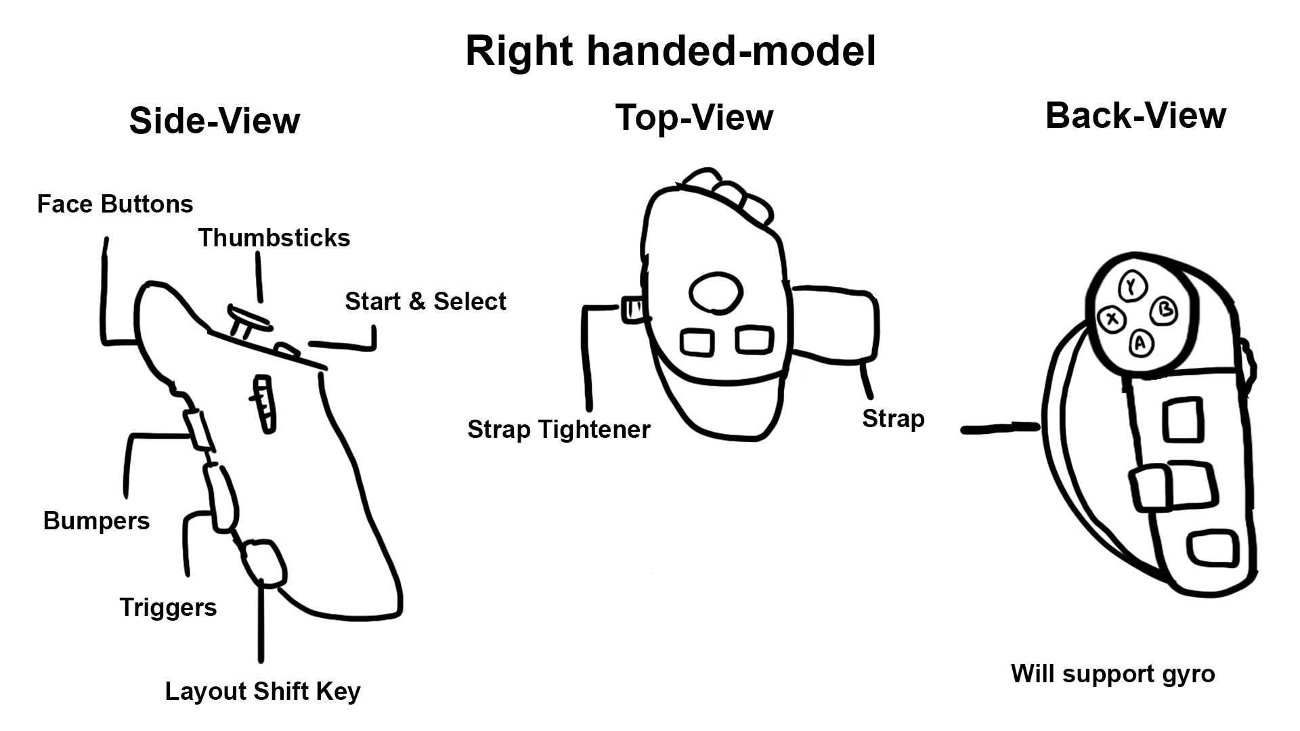
Final Idea
The idea that we will be implementing is a controller that will be strapped to your upper palm to allow the usage of every finger. To strap it on, a gear to tighten and loosen the strap will be on the side (see sketch below).
The buttons on the controller will be as follows:
Four face buttons on index finger
Tilt button for bumpers on the middle finger
Individual triggers on the ring finger
Layout shift Button on the pinkie finger
Joystick on the thumb
Two Menu buttons

Slide 9
Planning

Slide 10
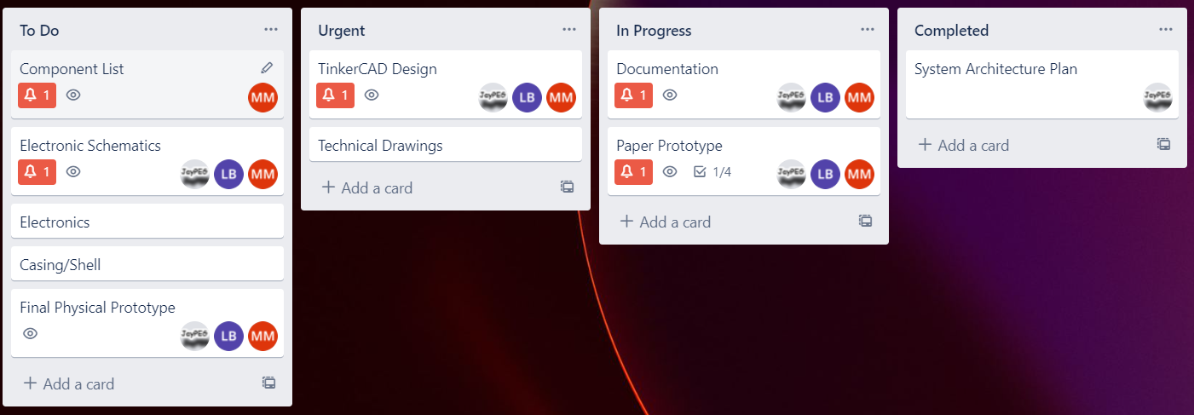
Planning
We will be using a trello board to keep track of all tasks

Slide 11
The End

